Slide 1
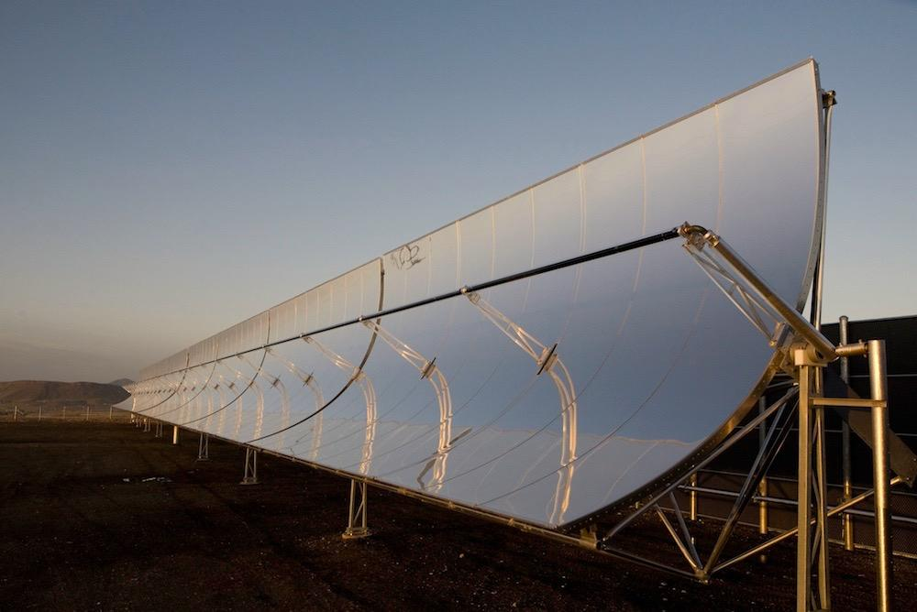

The Self-Oriented Solar Mirror
Anna Simons
Jan Latko
José Hugo Valiente
Margot Gutscoven
Raymond Quinn

Slide 2
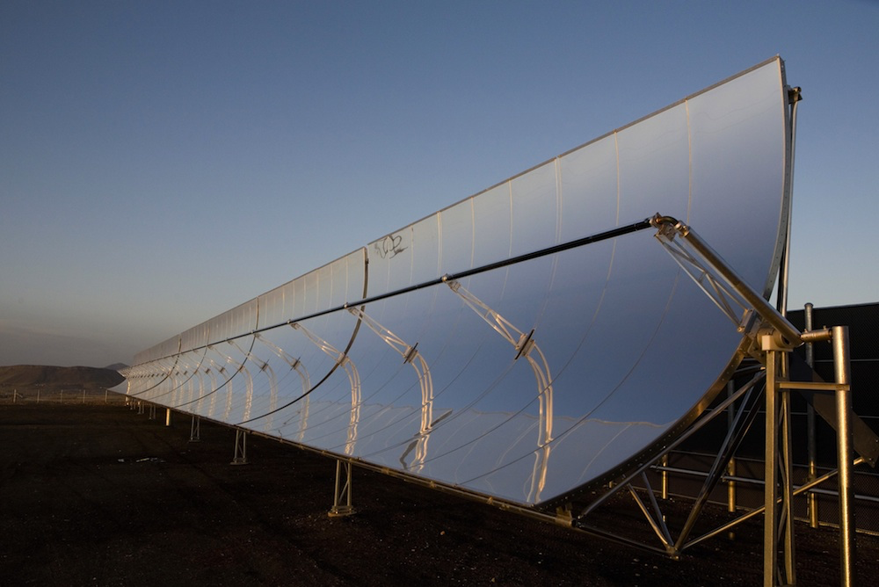
Table of content
Introduction
Suno
State of the Art
Project Management
Marketing Plan
Eco-Efficiency Measures for Sustainability
Ethical and Deontological Concerns
Project Development
Conclusions

Slide 3
Table of content
Introduction
Suno
State of the Art
Project Management
Marketing Plan
Eco-Efficiency Measures for Sustainability
Ethical and Deontological Concerns
Project Development
Conclusions

Slide 4
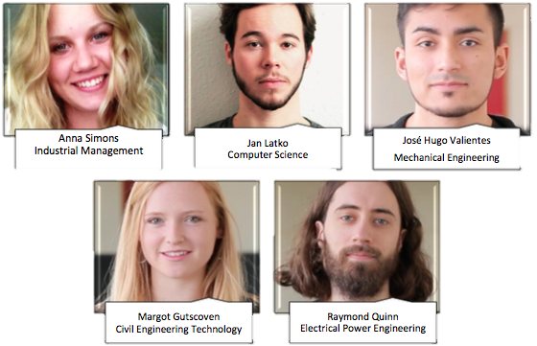
Introduction
The Self-Oriented Solar mirror: SUNO

Slide 5
Table of content
Introduction
Suno
State of the Art
Project Management
Marketing Plan
Eco-Efficiency Measures for Sustainability
Ethical and Deontological Concerns
Project Development
Conclusions

Slide 6
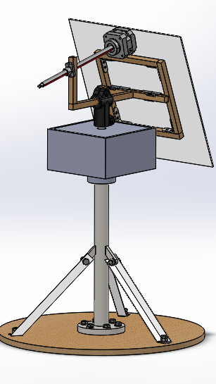
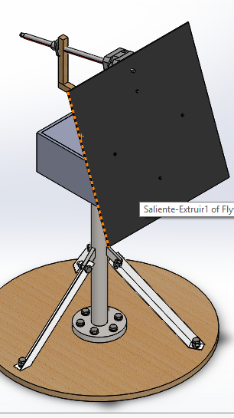
SUNO
SUNO Prototype

Slide 7
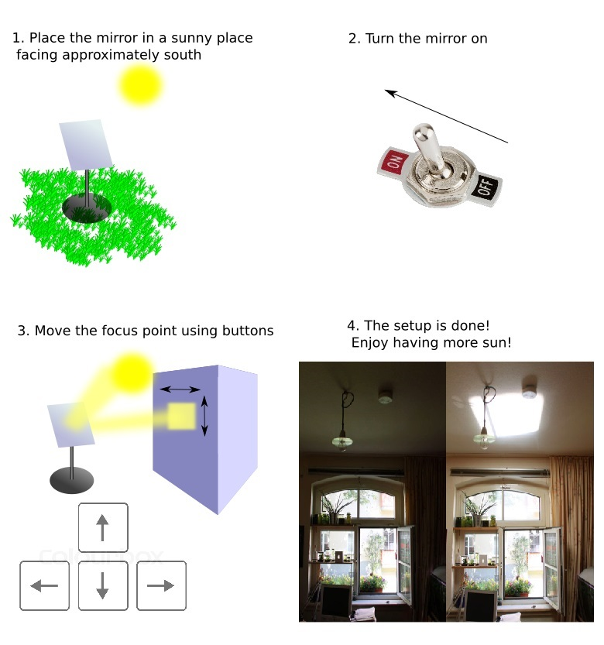
SUNO - Use Case
Place the mirror in a sunny place facing approximately south
2. Turn the mirror on
3. Move the focus point using buttons
4. The setup is done! Enjoy having more sun

Slide 8
Table of content
Introduction
Suno
State of the Art
Project Management
Marketing Plan
Eco-Efficiency Measures for Sustainability
Ethical and Deontological Concerns
Project Development
Conclusions

Slide 9
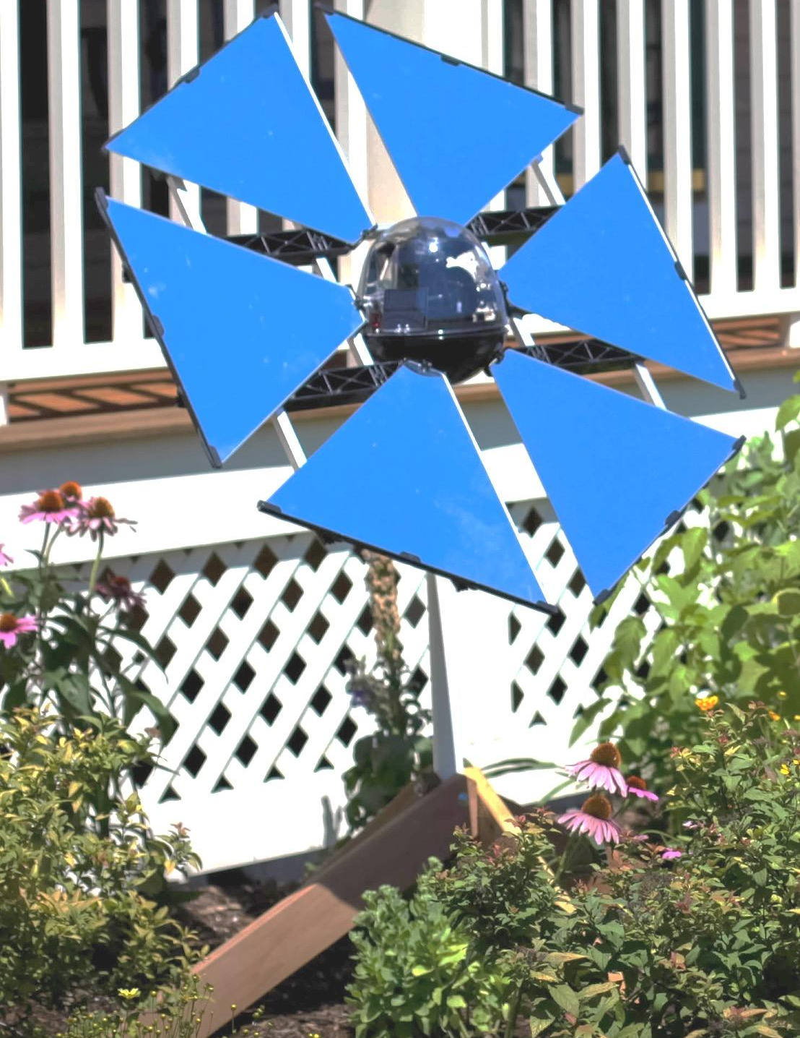
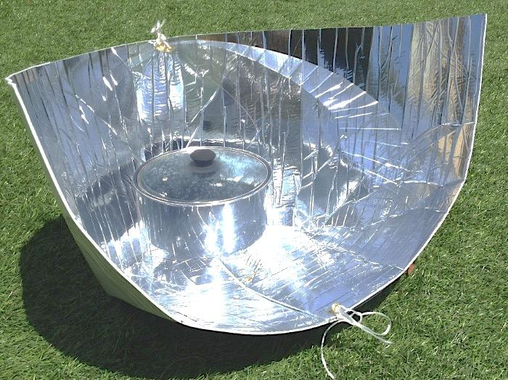
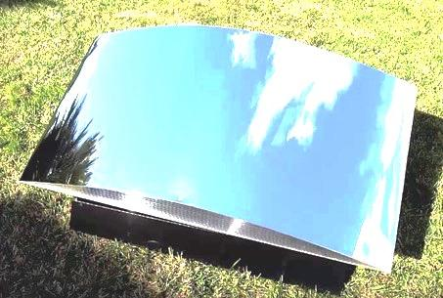
Purposes of Solar Mirror
Heliostat
  Light up a room
Cooking Mirror
  Heat food
Agricultural Solar Mirror
  Put under a tree

Slide 10
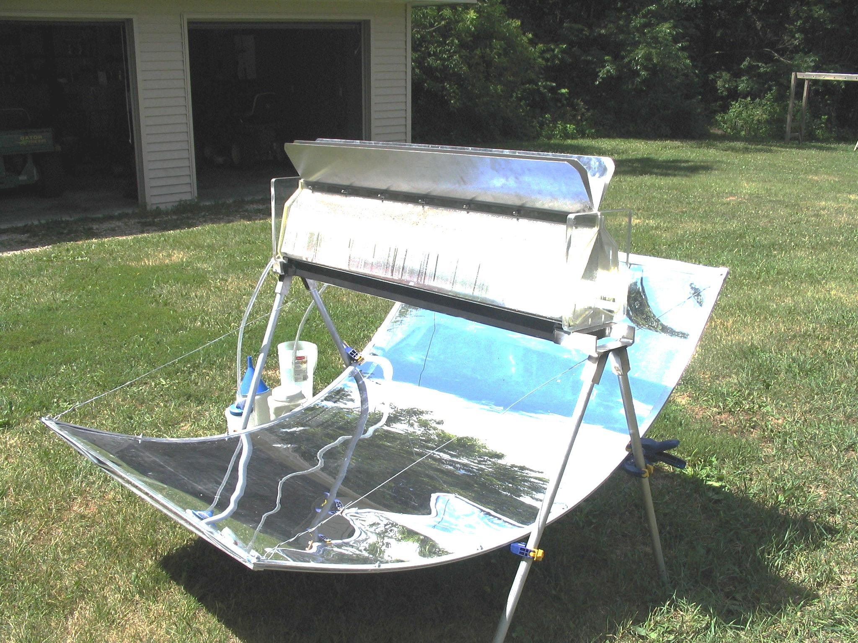
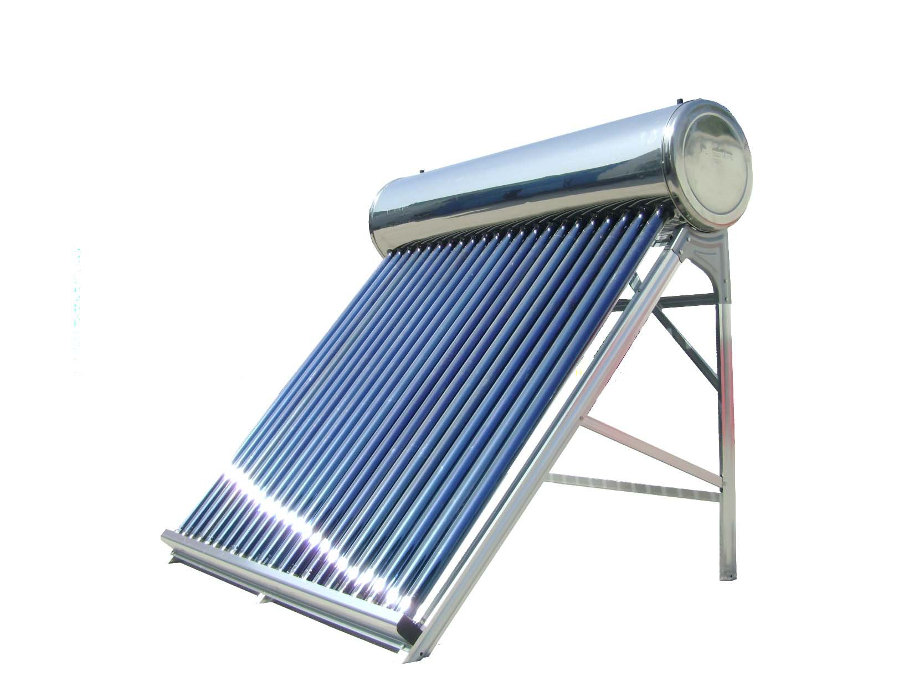
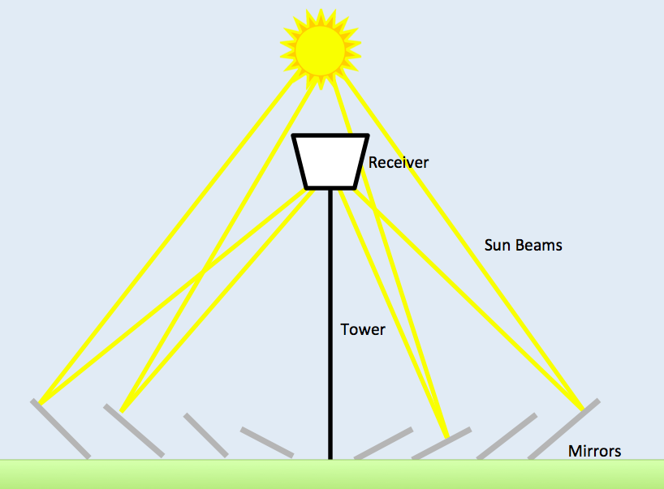
Purposes of Solar Mirror
Desalination
  Clean Water in 3th World countries
Water Heating
  Heat solar water heater
Solar Energy Production
  Store energy

Slide 11
Table of content
Introduction
Suno
State of the Art
Project Management
Marketing Plan
Eco-Efficiency Measures for Sustainability
Ethical and Deontological Concerns
Project Development
Conclusions

Slide 12

PM Main Objectives
SCOPE
TIME
COST
QUALITY
HUMAN RESOURCES

Slide 13
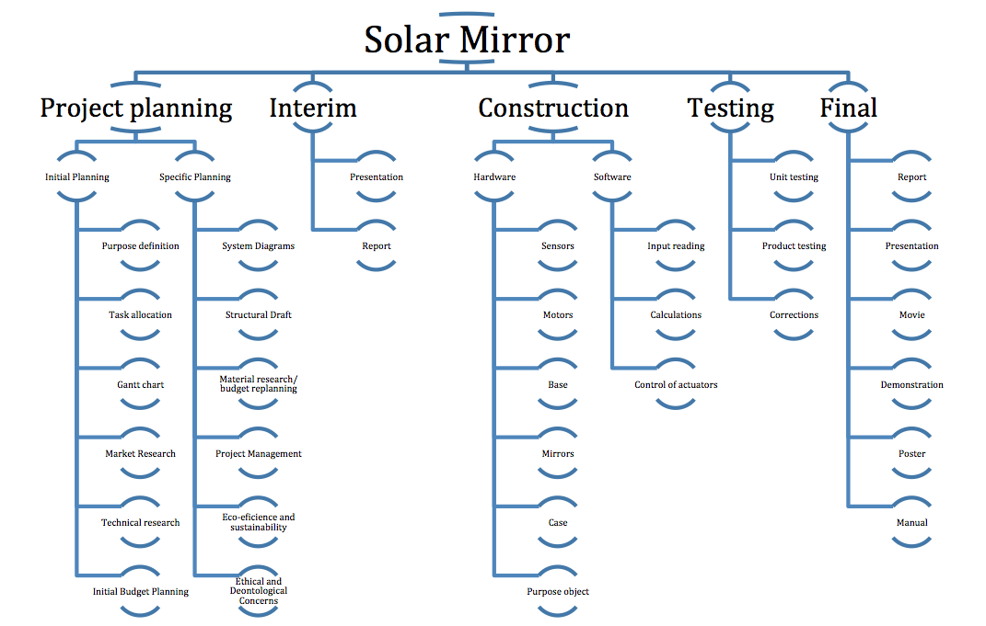
SUNO WBS

Slide 14
Table of content
Introduction
Suno
State of the Art
Project Management
Marketing Plan
Eco-Efficiency Measures for Sustainability
Ethical and Deontological Concerns
Project Development
Conclusions

Slide 15
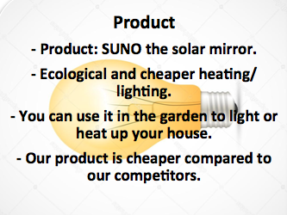
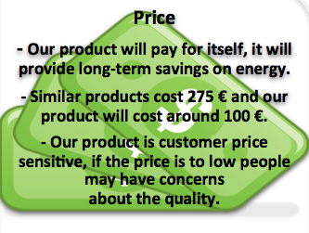
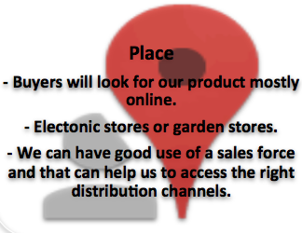

4P Marketing mix

Slide 16
Table of content
Introduction
Suno
State of the Art
Project Management
Marketing Plan
Eco-Efficiency Measures for Sustainability
Ethical and Deontological Concerns
Project Development
Conclusions

Slide 17
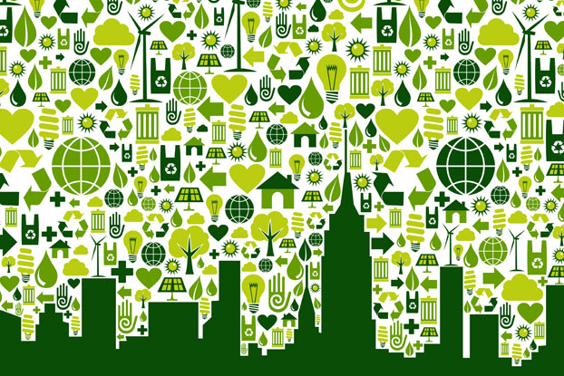
Main Goals In Sustainability
Environmental
  Choice of materials: PVC, MDF, Steel, Aluminium, pine tree
Economical
  Optimise use of existing resources
Social
  Manual
  Ecological product

Slide 18
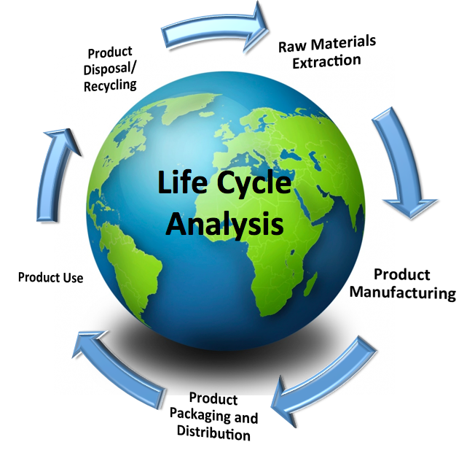
Life Cycle Analysis

Slide 19
Table of content
Introduction
Suno
State of the Art
Project Management
Marketing Plan
Eco-Efficiency Measures for Sustainability
Ethical and Deontological Concerns
Project Development
Conclusions

Slide 20

Ethical and Deontological Concerns
Engineering ethics
Sales and marketing ethics
Environmental ethics
Liability

Slide 21
Table of content
Introduction
Suno
State of the Art
Project Management
Marketing Plan
Eco-Efficiency Measures for Sustainability
Ethical and Deontological Concerns
Project Development
Conclusions

Slide 22
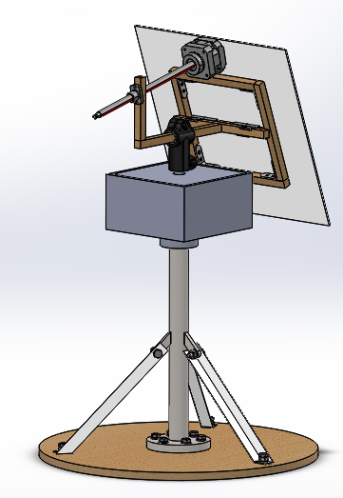
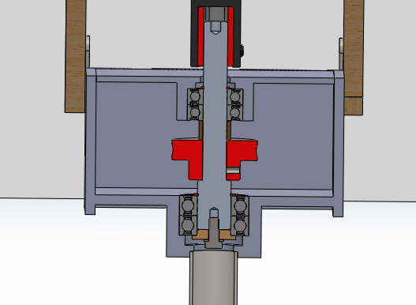
Technology movement

Slide 23
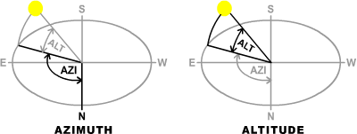
Sun Tracking
Longitude
Latitude
Time
Azimuth
Altitude

Slide 24


Position Feedback
ROBUST
SOLUTION
PROTOTYPE
SOLUTION
counting steps
+
resetting
absolute
encoder

Slide 25
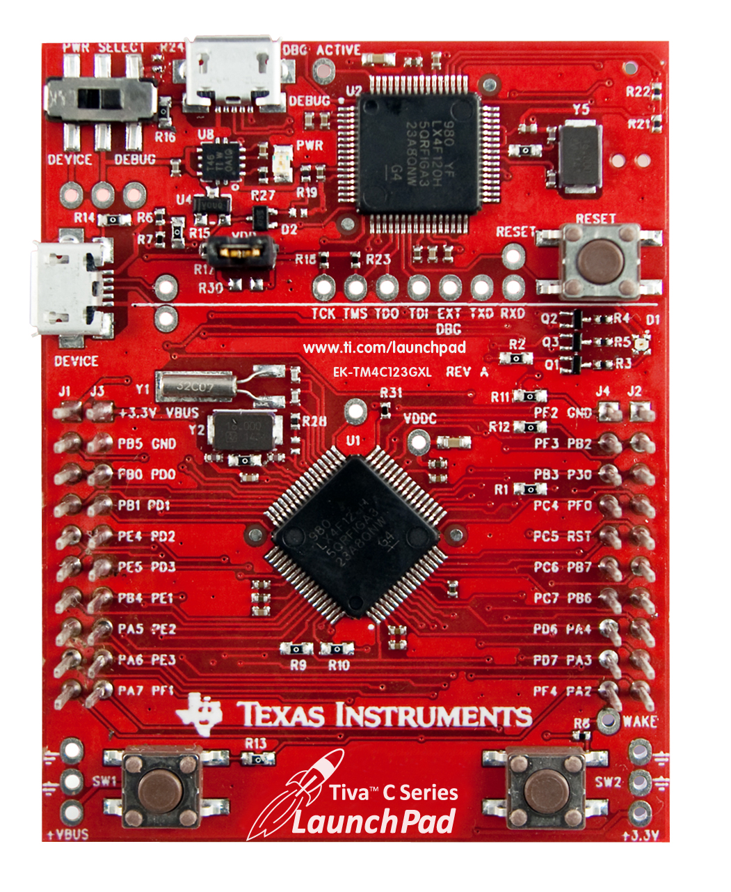

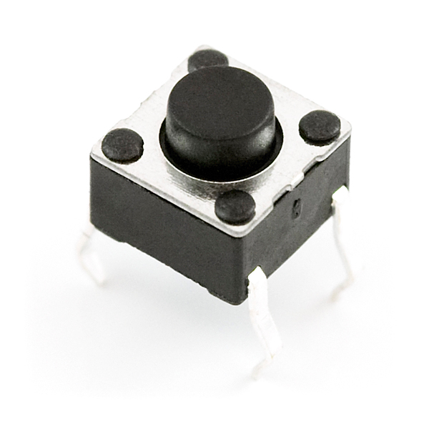
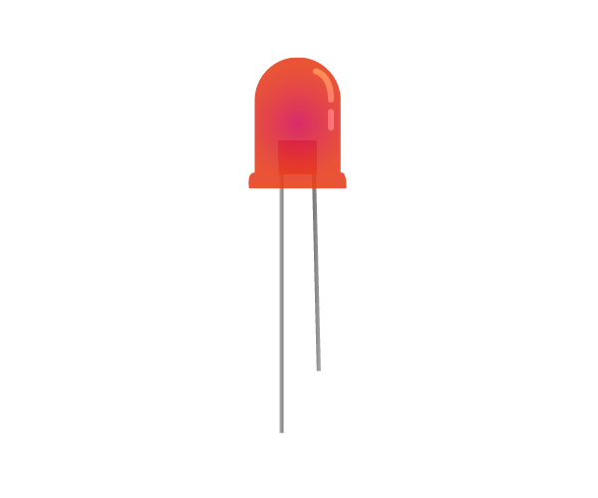
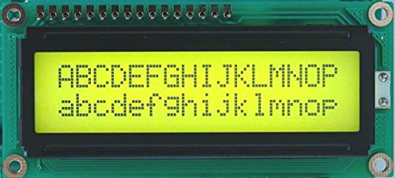
Components

Slide 26
Table of content
Introduction
Suno
State of the Art
Project Management
Marketing Plan
Eco-Efficiency Measures for Sustainability
Ethical and Deontological Concerns
Project Development
Conclusions

Slide 27
Hands On!
electronics
software
test and fix !
test and fix !
test and fix !
hardware
control system
test and fix !
prototype
test and fix !

Slide 28
THE END

Slide 29
References
http://naturalfrequency.com/wiki/solar-position
https://xtronics.com/wiki/LinuxCNC.html
http://www.kollmorgen.com/uploadedImages/kollmorgencom/Products/Motors/Stepper/CT_Series/CT_Series_Stepper_Motor_LARGE.jpg
http://processors.wiki.ti.com/images/e/e3/TITivaLaunchpad2A.jpg
http://ecx.images-amazon.com/images/I/41WzWE5uF5L.jpg
https://cdn.sparkfun.com//assets/parts/9/0/00097-03-L.jpg
https://www.raspberrypi.org/learning/images/components/led.png

