Slide 1
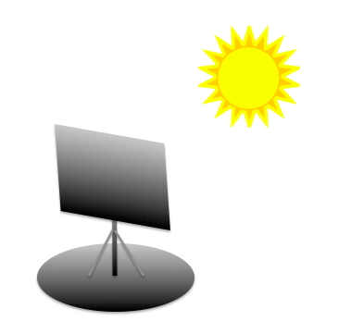

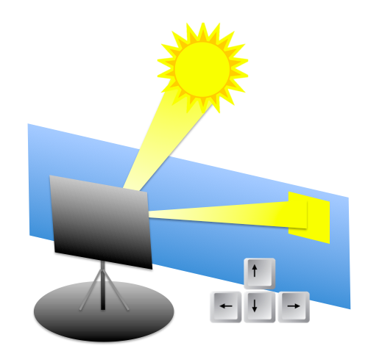
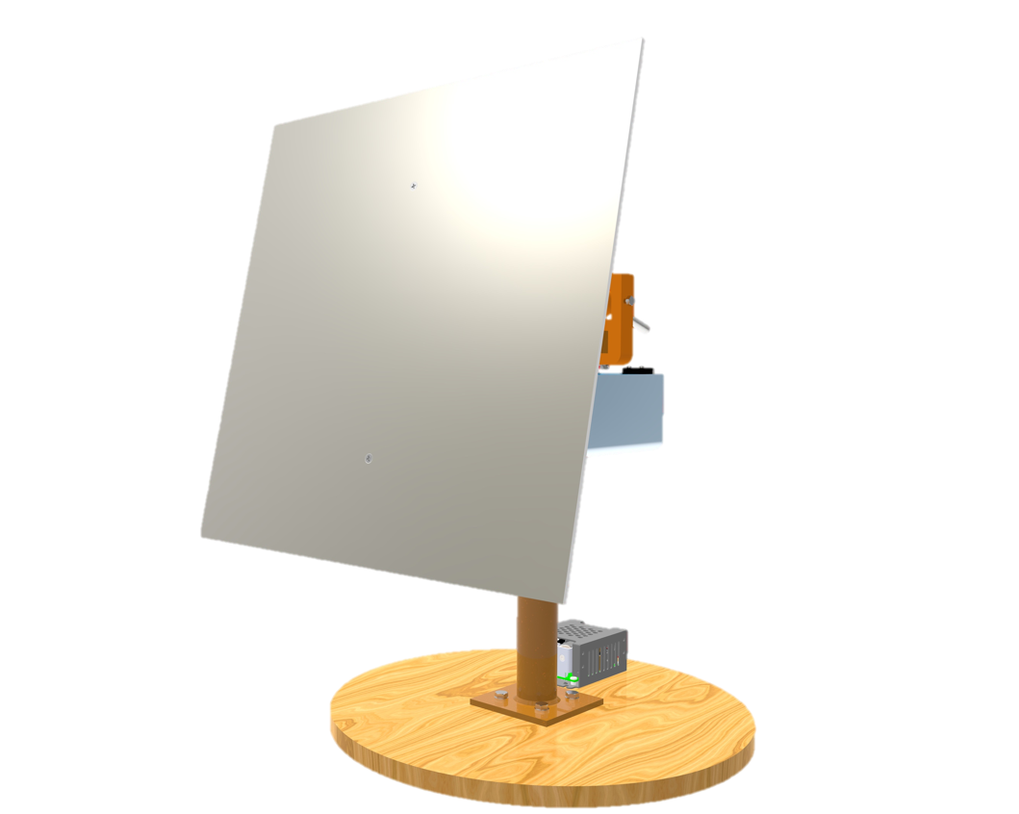


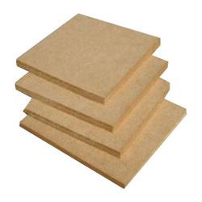
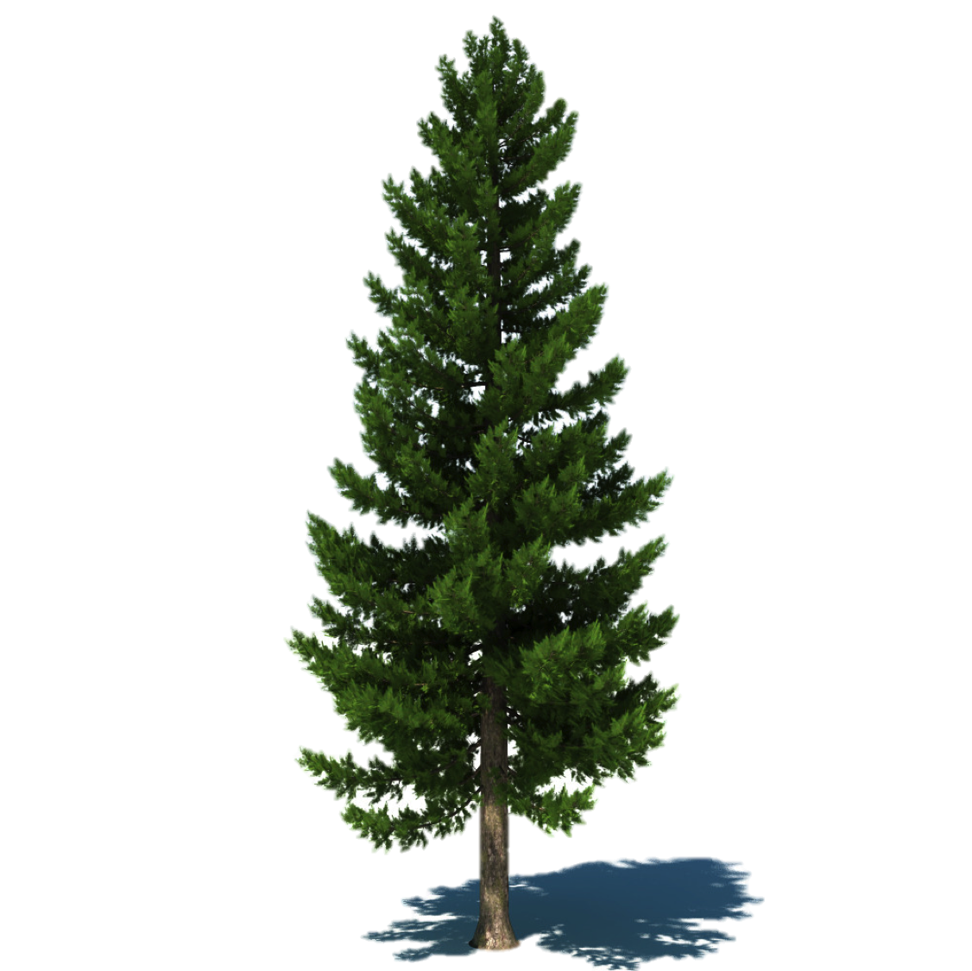
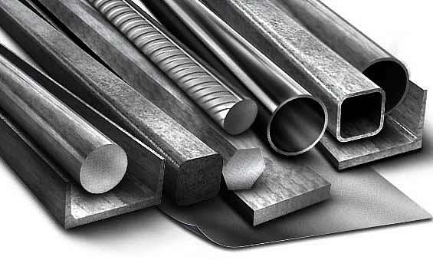
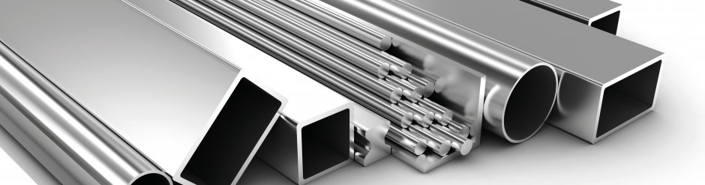
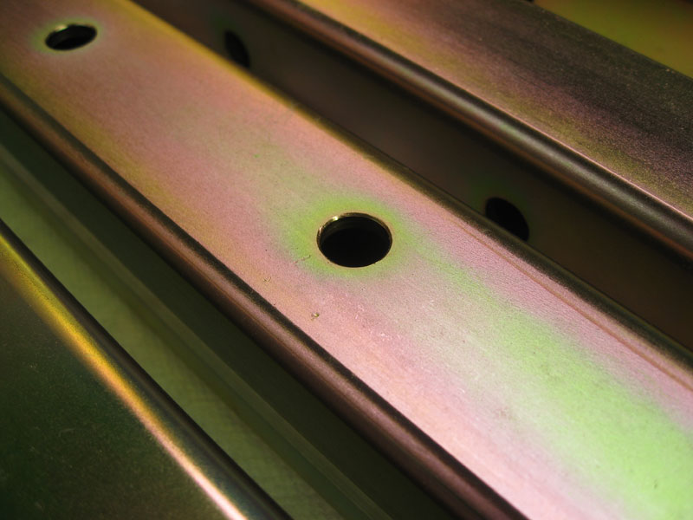
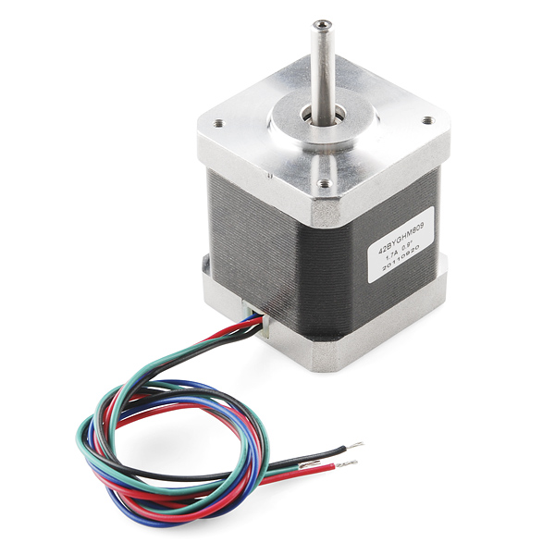
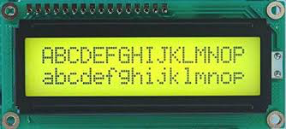
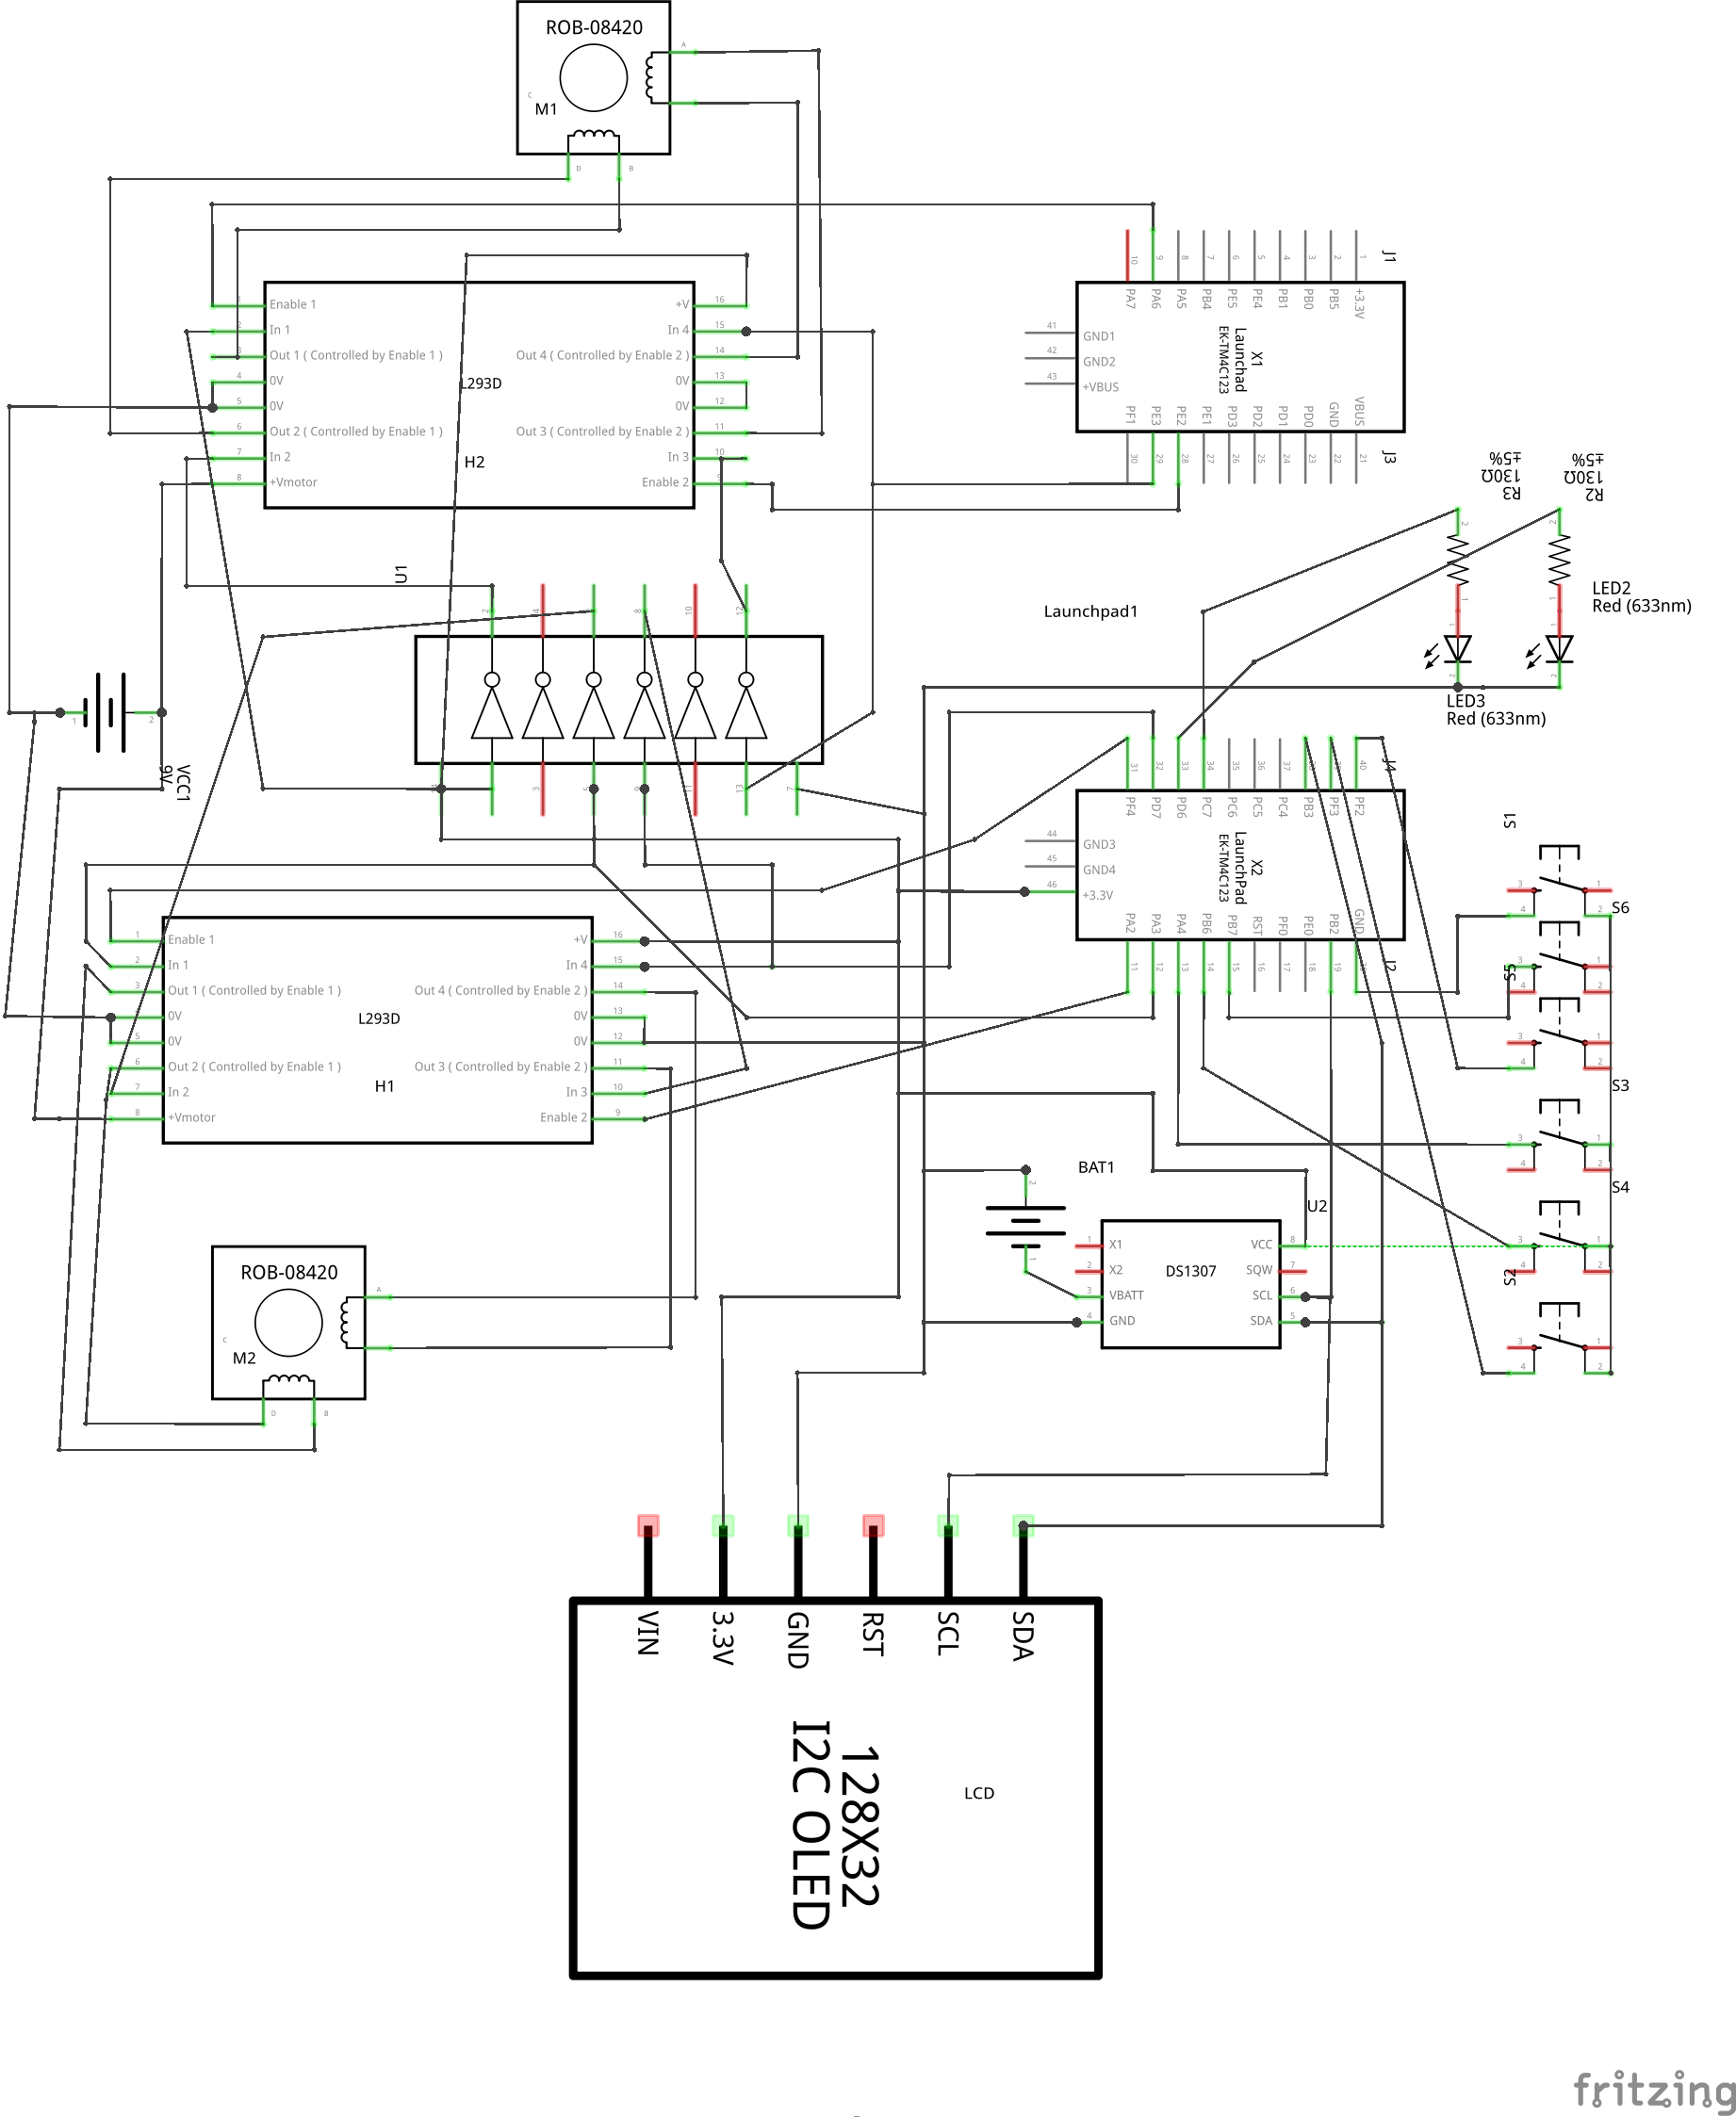
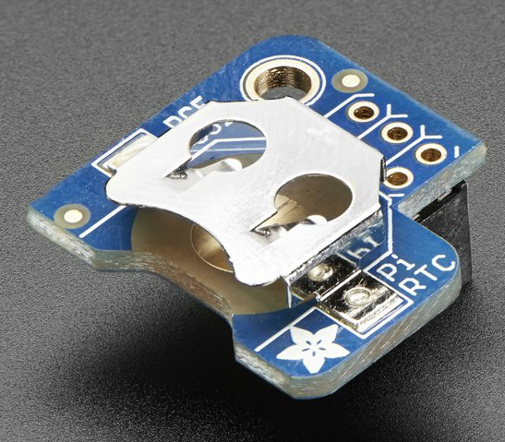
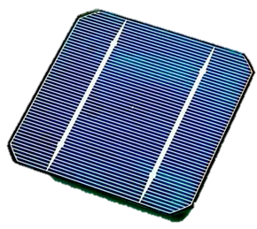
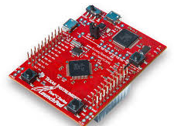
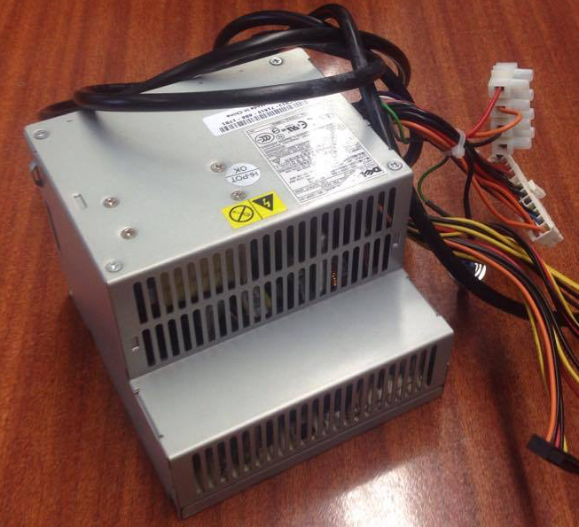

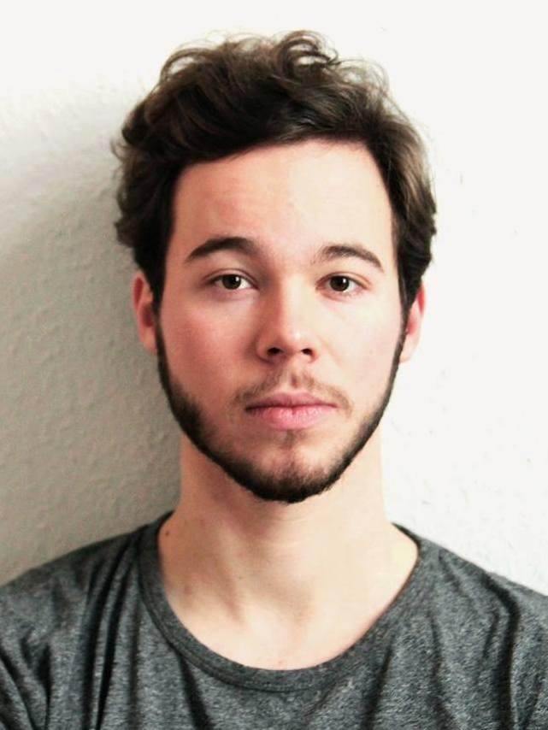
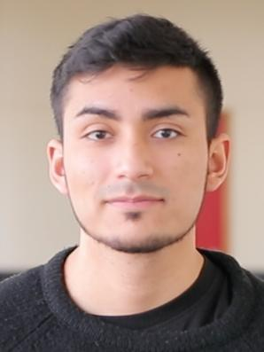
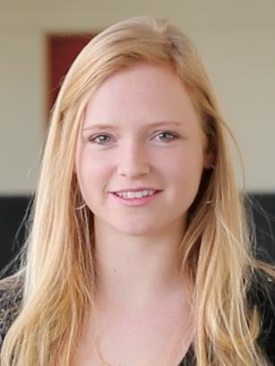


SUNO - The self-oriented Solar Mirror
An EPS@ISEP project
Anna Simons, Jan Latko, Jose Hugo Valiente, Margot Gutscoven, Ramond Quinn
What is the solar mirror?
Manual
The solar mirror is a simple way to harness solar energy and to transform it into energy that can be used daily. Raw materials are overused and new sources of energy are needed.
1
Place the mirror in a sunny place facing the south
2
Turn the mirror on
3
Move to the focus point using the buttons
Materials
Polyvinyl
Chloride
(PVC) ^{[2]}
Pine Tree ^{[4]}
Aluminum ^{[6]}
Medium
Density
Fiberboard
(MDF) ^{[3]}
Steel ^{[5]}
Zinc Plated Metal ^{[7]}
Goal
Make a self oriented solar mirror
Mirror must track the movement of the Sun and
Mirror must reflect the sunlight onto a predefined area
Make the product costumer friendly
Components
Bipolar stepper motor ^{[8]}
Power supply
Solar Panel (Final product) ^{[9]}
An external power supply (Prototype)
LCD display (Final product) ^{[10]}
RTC
Tiva C ^{[11]}
Others
LEDs and buttons (5 and on/off switch)
Some additional resistors might be needed for the buttons as a pull down and capacitors for debounce.
Schematics
The good resolution allows precise movement and easy control
High torque and a holding torque without power supply
Has to support SPI or I2C protocol to minimize number of pins used
To keep track of time, to know the position of the sun, the exact time has to be known
It has to have its own battery and it has to support the I2C protocol.
The product is supposed to work only during the day and changes its position towards the Sun.
The system will hibernate when the Sun is out of range, which will minimize the power consumption.
Inexpensive, self-contained, single-board microcontroller
Ideal because two different voltages are needed
Supplies 12 volt for the motor and 5 volt for the Arduino board
The team
References
[1] Electrical engineering Community, 2014. Difference between open loop and closed loop systems. 28/05/2017.
[2] Cands Plactics. Available: https://candsplastics.com, 28/05/2017.
[3] Indiamart. Available: https://dir.indiamart.com/jaipur/medium-density-fiberboard.html. 28/05/2017.
[4] Turbosquid. Available: https://www.turbosquid.com/3d-models/3dsmax-pine-tree/390460. 28/05/2017.
[5] New Steel, miscellaneous. Available: http://news.steel-360.com/miscellaneous/say-yes-steel/. 28/05/2017.
[6] Central Aluminium. Available: http://www.centralaluminum.com/index.html. 28/05/2017.
[7] Del Splating, Zinc. Available: http://www.delsplating.com/zinc-plating.html. 28/05/2017.
[8] Ocean controls, Bipolar stepper motor. Available: https://oceancontrols.com.au/SFM-002.html. 01/06/2017.
[9] Wikipedia, solar cell. Available: https://en.wikipedia.org/wiki/Solar_cell. 01/06/2017.
[10] Amazon, images. Available: http://ecx.images-amazon.com/images/I/41WzWE5uF5L.jpg. 01/06/2017.
[11] Ti, LaunchPad. Available: https://www.ti.com/ww/en/launchpad/launchpads-connected-ek-tm4c123gxl.html. 01/06/2017.
Anna Simons
Industrial Management
Finland
Jan Latko
Computer Science
Poland
José Hugo Valiente Saltos
Mechanical Engineering
Spain
Margot Gutscoven
Building Engineering
Belgium
Raymond Quinn
Electrical Power Engineering
Scotland
Promotors and advisors: Abel Duarte , Fernando Ferreira, Maria Benedita Malheiro, Maria Cristina Ribeiro, Manuel Silva , Paulo Ferreira, Pedro Barbosa Guedes EPS@ISEP | Spring 2017

